Slide 1


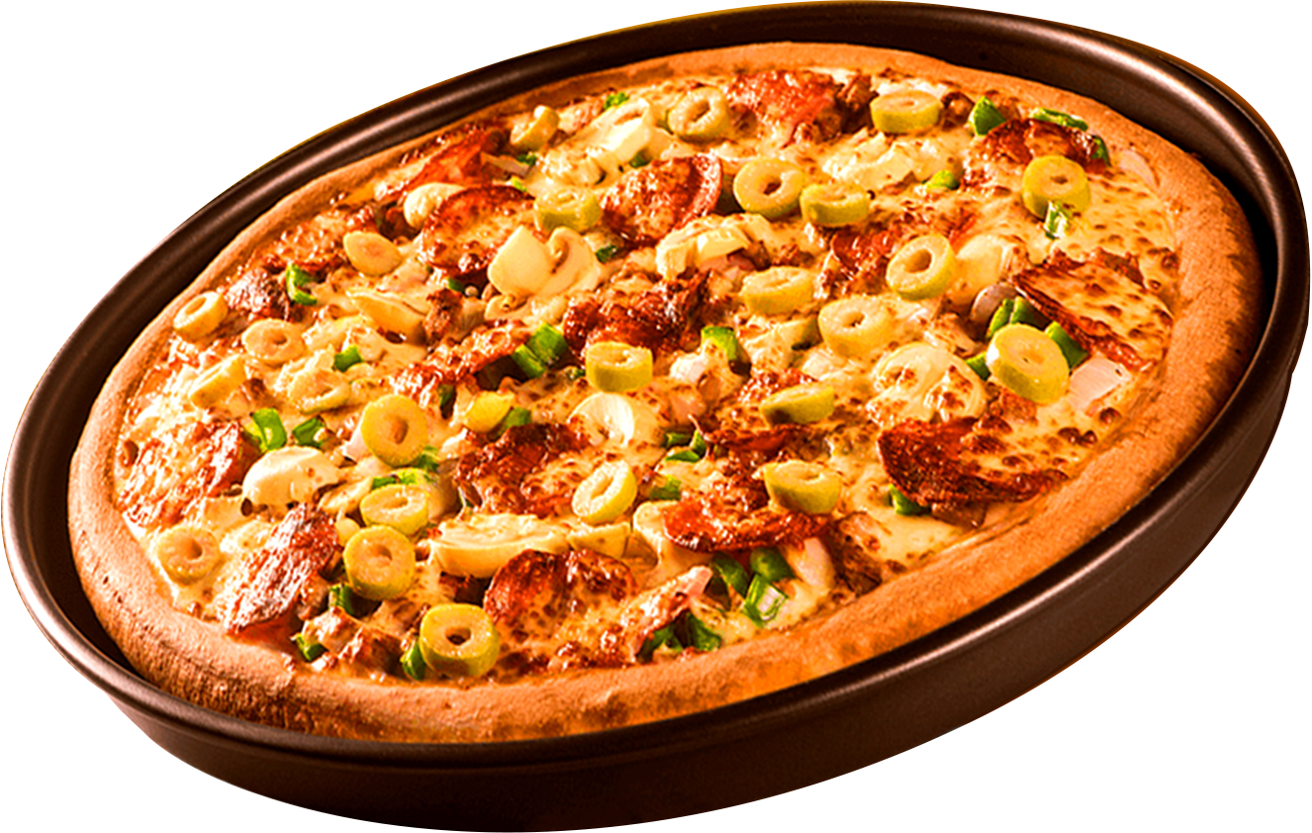
Hello I’m Anish Kumar Mishra !!
WELCOME TO
PIZZA ANALYSIS
WHATCH
NOW
Start Your Slide

Slide 2
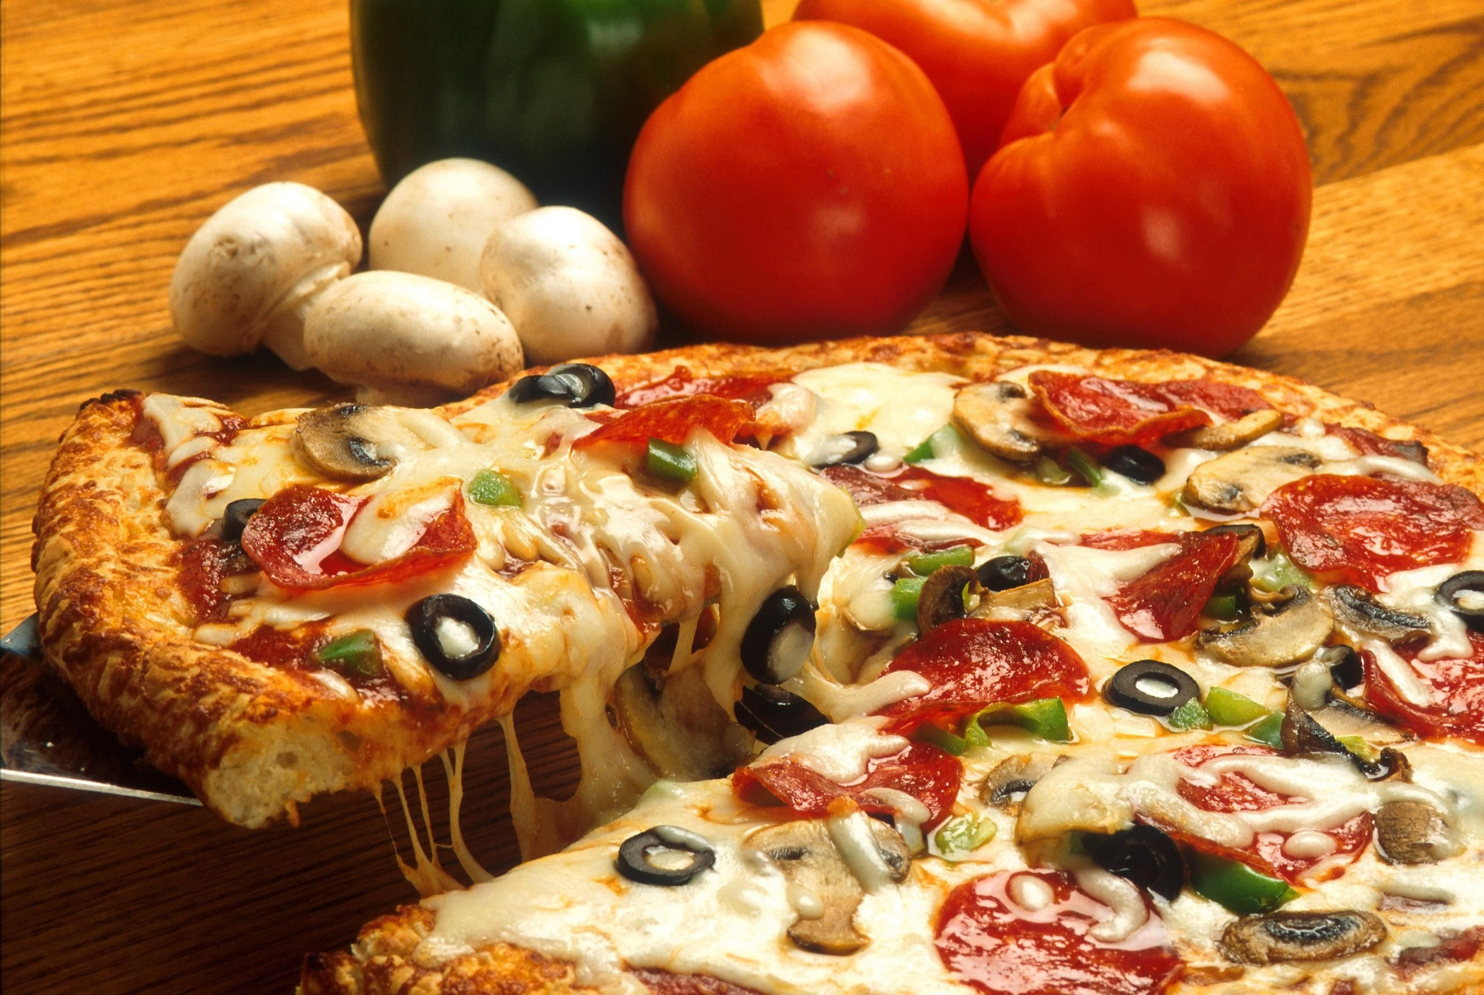
ABOUT OUR BASIC PIZZA ANALYSIS
Our Passion for Pizza
Retrieve the total number of orders placed.
Calculate the total revenue generated from pizza sales.
Identify the highest-priced pizza.
Identify the most common pizza size ordered.
List the top 5 most ordered pizza types along with their quantities.

Slide 3
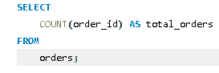
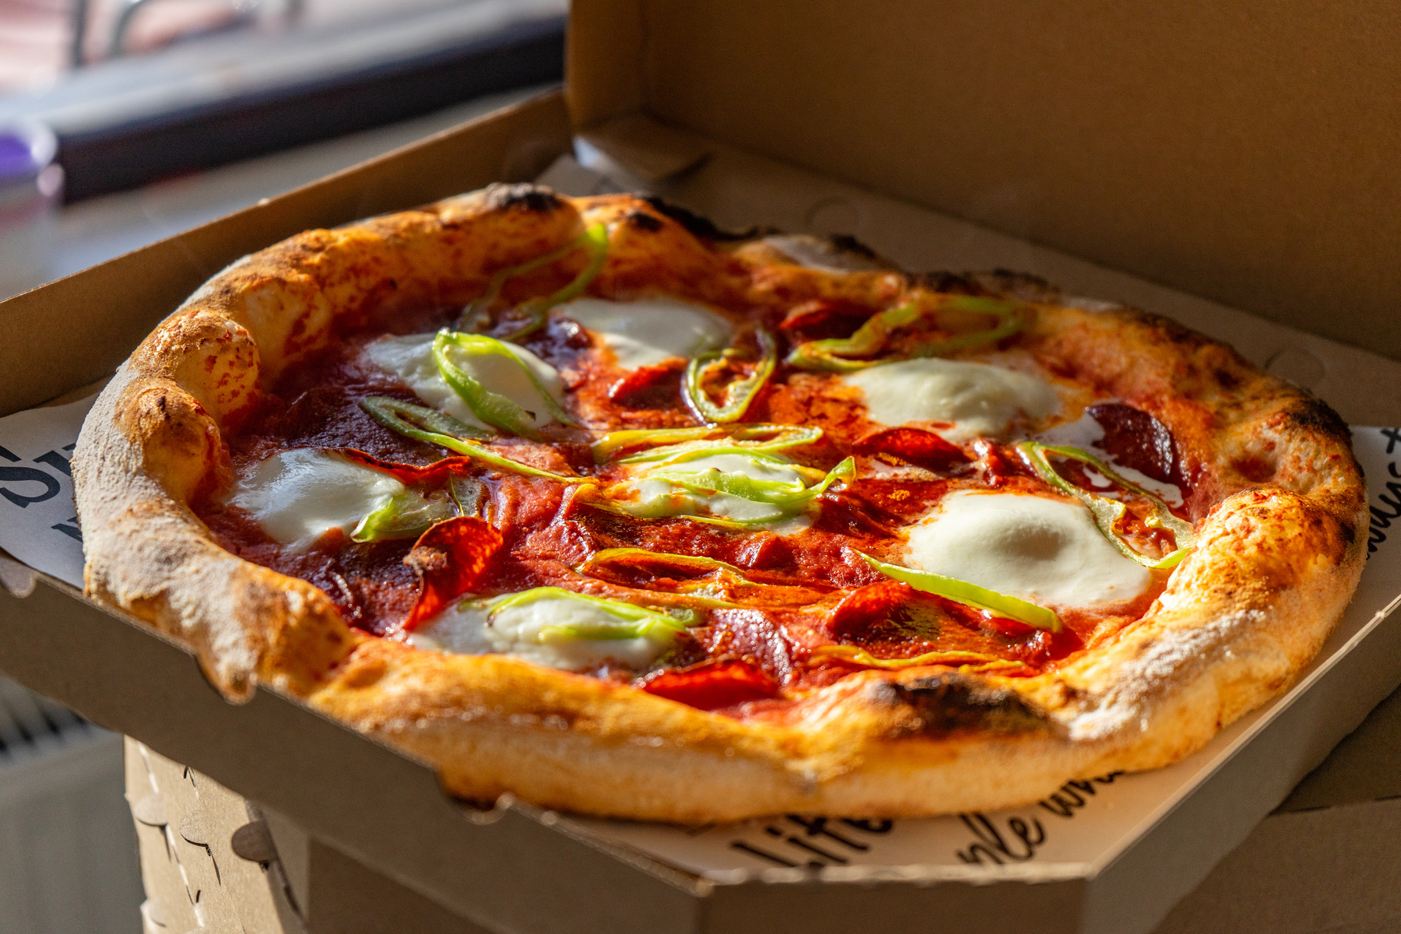
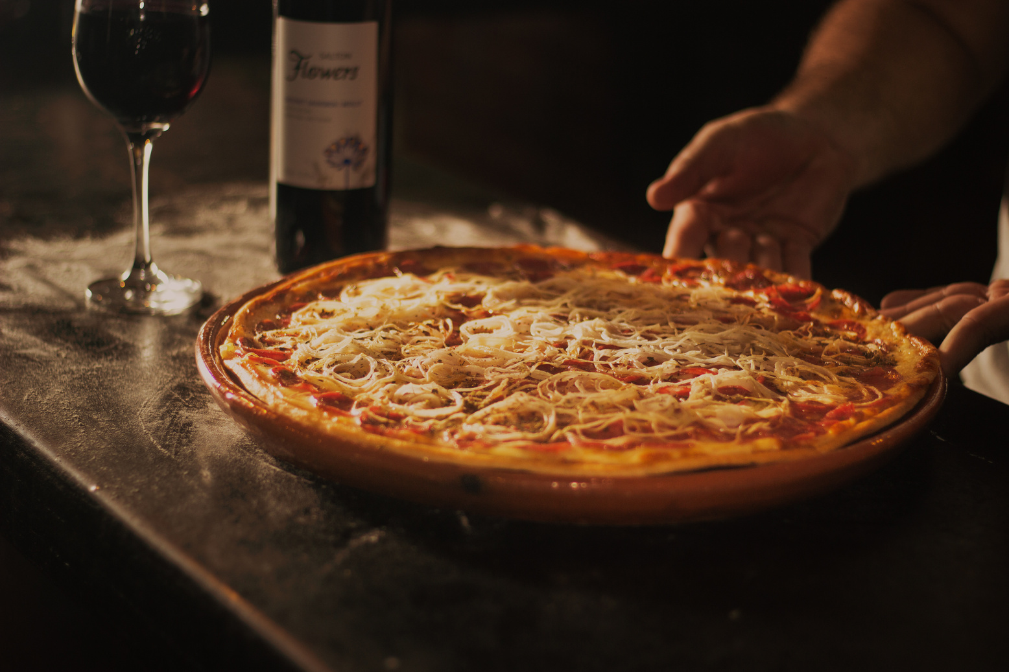
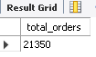
RETRIEVE THE TOTAL NUMBER OF ORDERS PLACED.
2024

Slide 4
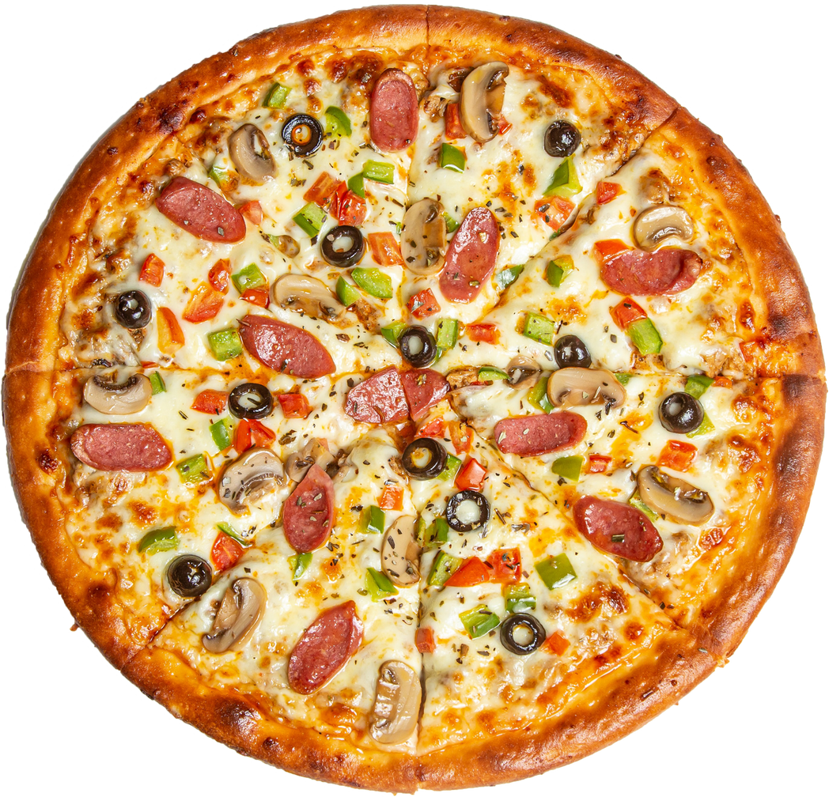
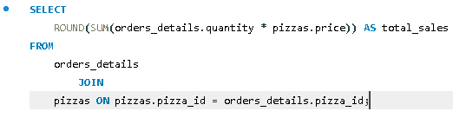
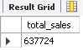
CALCULATE THE TOTAL REVENUE GENERATED FROM PIZZA SALES.

Slide 5
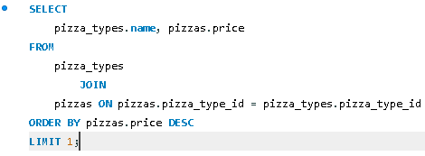
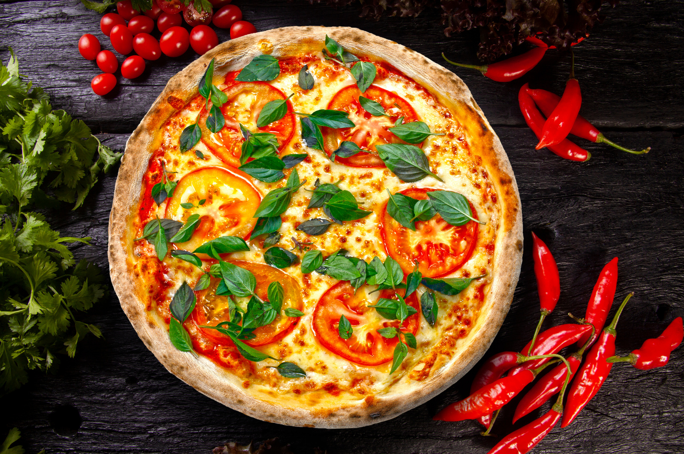
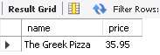
IDENTIFY THE HIGHEST-PRICED PIZZA.
$37
The Greek Pizza

Slide 6
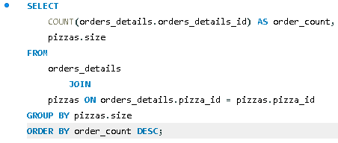
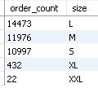
IDENTIFY THE MOST COMMON PIZZA SIZE ORDERED.

Slide 7

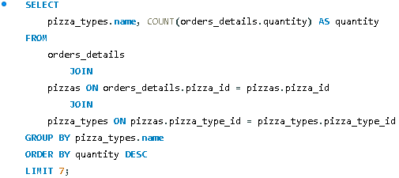
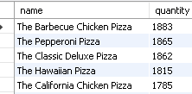
LIST THE TOP 5 MOST ORDERED PIZZA TYPES ALONG WITH THEIR QUANTITIES.

Slide 8
ABOUT OUR INTERMEDIATE PIZZA ANALYSIS
Our Passion for Pizza
Join the necessary tables to find the total quantity of each pizza category ordered.
Determine the distribution of orders by hour of the day.
Join relevant tables to find the category-wise distribution of pizzas.
Group the orders by date and calculate the average number of pizzas ordered per day.
Determine the top 3 most ordered pizza types based on revenue.

Slide 9
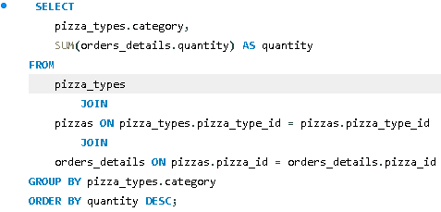
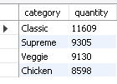
JOIN THE NECESSARY TABLES TO FIND THE TOTAL QUANTITY OF EACH PIZZA CATEGORY ORDERED.

Slide 10
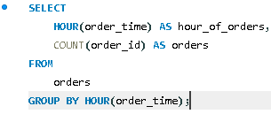
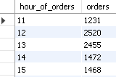
DETERMINE THE DISTRIBUTION OF ORDERS BY HOUR OF THE DAY.

Slide 11
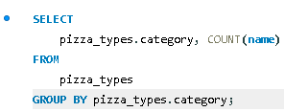
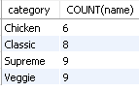
JOIN RELEVANT TABLES TO FIND THE CATEGORY-WISE DISTRIBUTION OF PIZZAS.

Slide 12
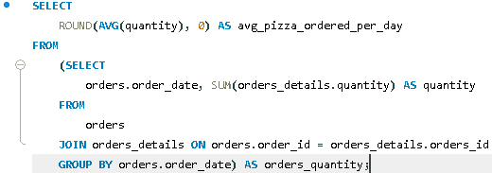
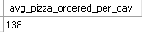
GROUP THE ORDERS BY DATE AND CALCULATE THE AVERAGE NUMBER OF PIZZAS ORDERED PER DAY.

Slide 13
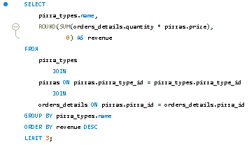
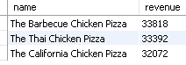
DETERMINE THE TOP 3 MOST ORDERED PIZZA TYPES BASED ON REVENUE.

Slide 14
Pizza Analysis Presentation
THANK YOU
FOR ATTENTION
https://www.linkedin.com/in/anish-kumar-196406277/
https://github.com/anishkumarmishra

